Slide 1
AIRBUS DAY INNOVATION CHALLENGE
AIRBUS – JADAVPUR UNIVERSITY
TEAM SENSORY FEATHERS
TEAM MEMBERS:-
1) SRINJAN BAGCHI ,
Email - srinjan.2001@gmail.com
Phone - 9163058733
U.G.-III ,
Department Of Mechanical Engineering ,
Jadavpur University
2) SHRINJOY PAUL ,
Email –shrinjoypaul23@gmail.com ,
Phone-9432218189 ,
U.G. – III ,
Department Of Mechanical Engineering ,
Jadavpur University
3) MAYUKHMALI DAS ,
Email - mayukhmalidas322@gmail.com
Phone - 8617748273
U.G.-III
Department Of Electronics And Telecommunication Engineering
Jadavpur University

Slide 2
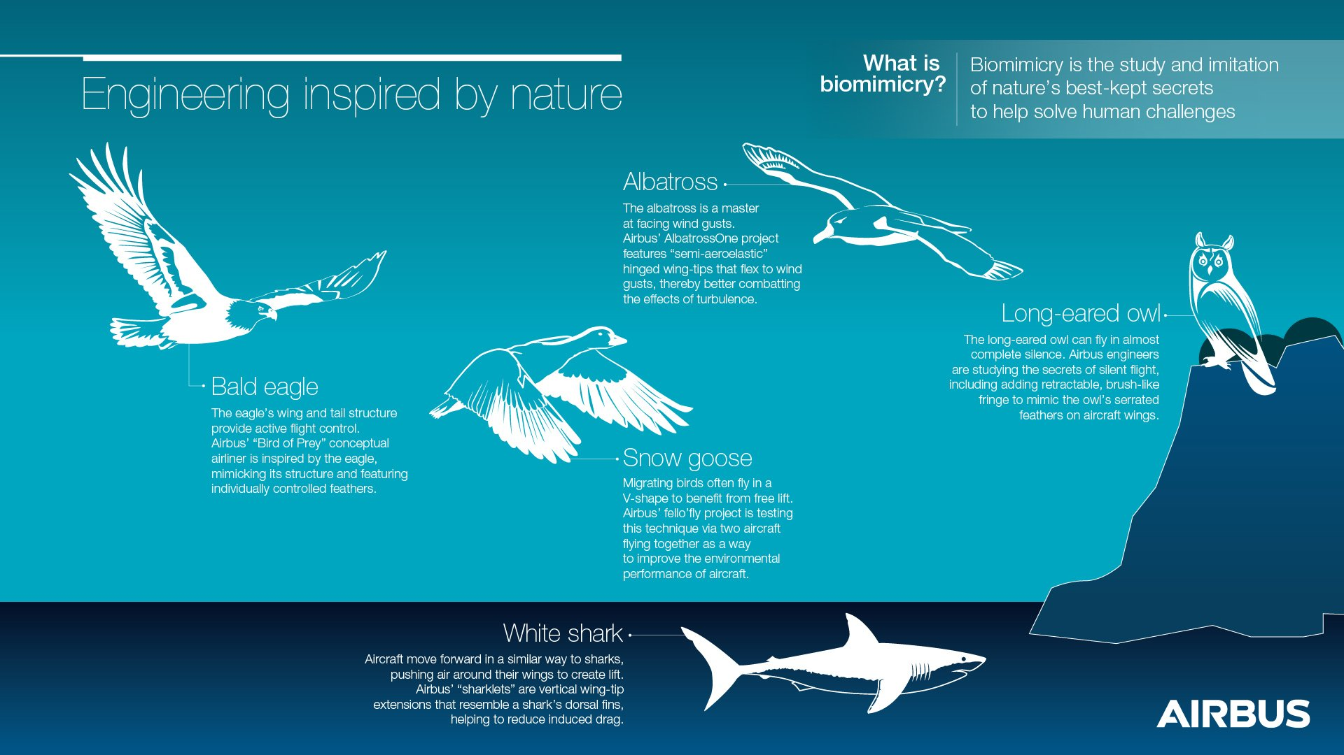
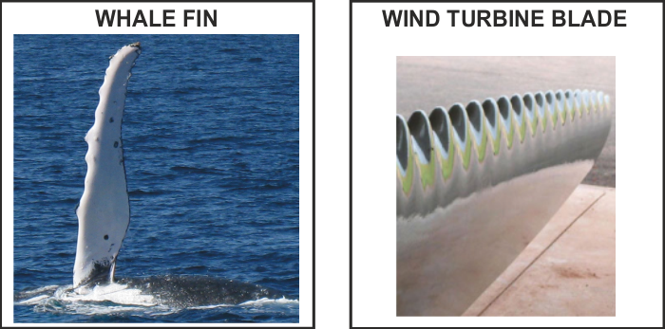
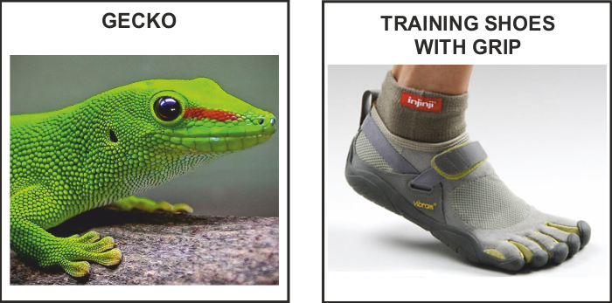
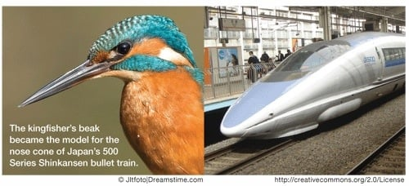
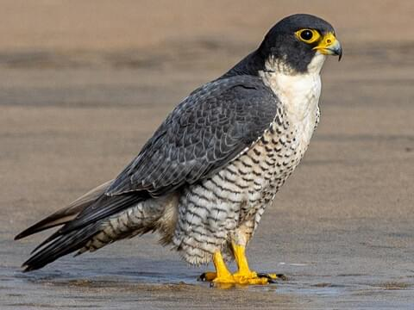
Bio-Inspired design ideas offers an empathetic understanding of how Nature around us works and ultimately where we fit in . It is a practice that learn , adapt from and mimic the strategies used by species for sustaining our lives. The goal is to create products and processes— new ways of living — that solve our greatest design challenges sustainably and in solidarity with all life on earth. This practice is commonly known as BIOMIMICRY and has profound applications in various sectors .
Bio-Inspired ideas / Biomimicry
Already Existing Biomimicry ideas
(1)
(2)
(3)
Kingfisher Beak
Bullet Train
Already Existing Biomimicry ideas employed by AIRBUS in the Aerospace industry includes –Project Fello’fly , Project Bird of Prey
Challenge :- Utilization of Bio-inspired Design for applications in Aerospace Ecosystem for safe & sustainable flight
OUR PROPOSED BIOLOGICAL MODEL
Peregrine Falcon
It is known to be the Fastest animal on the planet when performing the stoop (high-speed dive). (reaching more than 220 miles per hour ) .
The peregrine falcon (Falco peregrinus), also known as the peregrine , and historically as the duck hawk in North America, is a cosmopolitan bird of prey in the family Falconidae.
It can be found nearly everywhere on Earth, except extreme polar regions, very high mountains, and most tropical rainforests.
Wingspan of 74-120 cm.
Peregrine Falcon

Slide 3
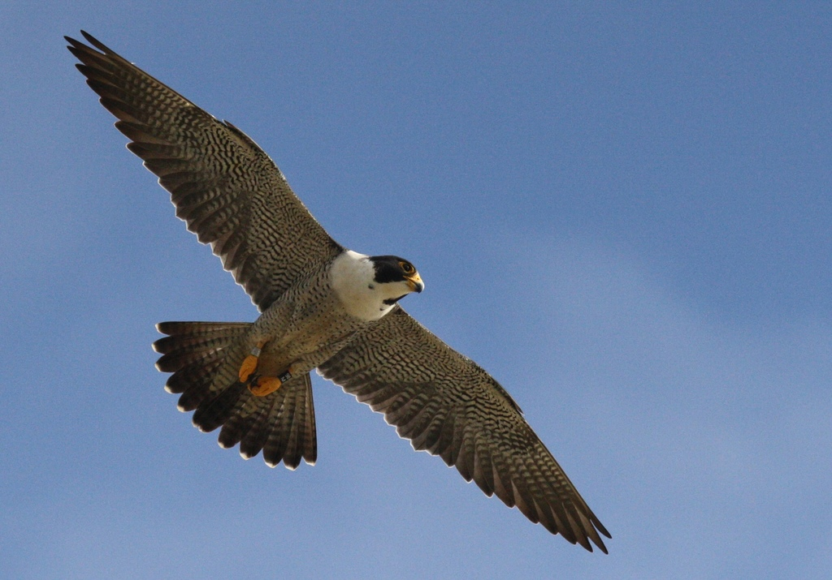
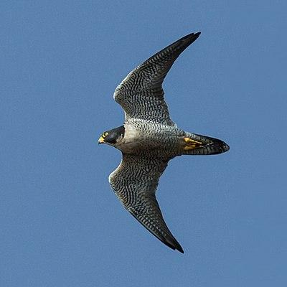
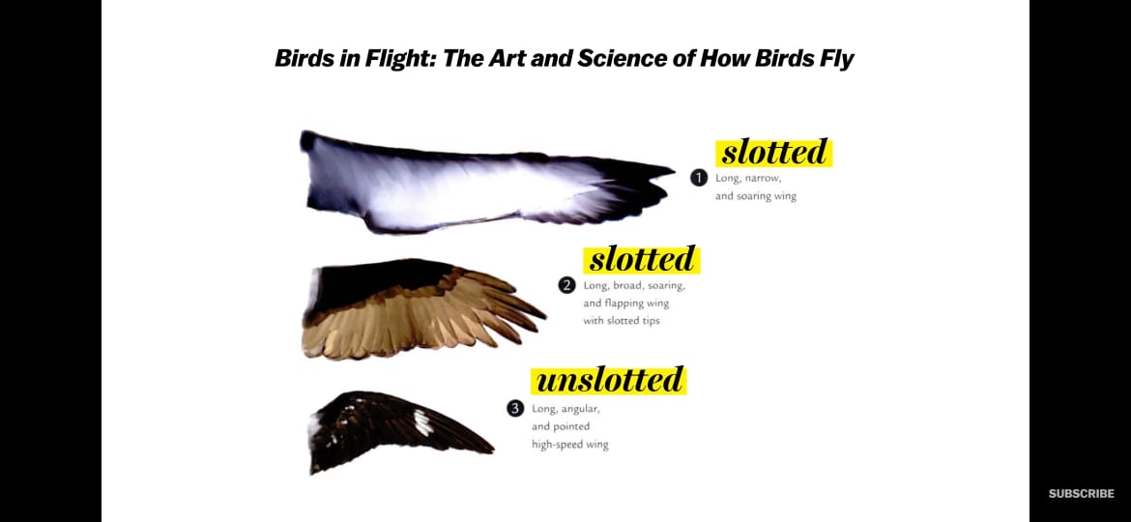
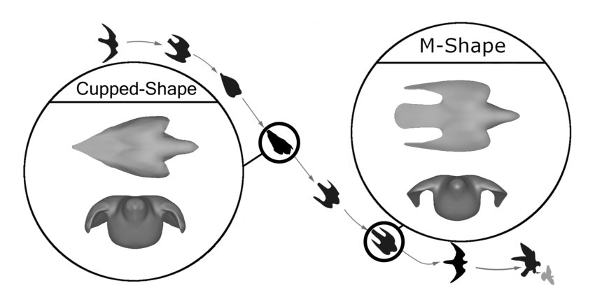
OUR IDEA
Unique Features of Peregrine Falcon
Adaptive wing shapes
Peregrine Falcons have unslotted , long angular wing shape which gives a significant advantage when it comes to high speed flying as required for Fighter aircrafts by significant reduction of drag force that resists the motion.
To maintain its altitude, the Peregrine Falcon extends its wings, therefore increasing the planform area, which causes greater lift and also drag. The Peregrine Falcon is relatively slow while extending its wings. When in need of speed ,the Falcon folds its wing and decreases area. The decrease in planform area, decreases amount of drag generated, therefore speeding up the Falcon significantly.
The special design of peregrine falcons can be applied to for aircraft with time/speed critic tasks such as interceptor/fighter jets
This special shape of wings has two advantages :-
Lesser projected area of the wings gives a reduced drag force ( resistive to aircraft motion) and thus lesser fuel consumption . This comes at the cost of a lesser lift force , but sufficient enough for the aircraft to fly.
Aircrafts are therefore capable of reaching speeds of about 3000 km h. With low planform area, Fighter jets are capable of going way beyond supersonic speeds
Peregrine Falcon
SOARING vs SPEEDING
Peregrine falcons are the fastest flying birds on Earth reaching a maximum speed of 242 miles per hour. Everything from its wingspan and shape to its feather design gives them the high speed flights. A peregrine falcon has to make a very precise dive to catch its prey. If the trajectory is even a little off, they can lose control and tumble but,realise that their flight is unstable and can adjust their flight to fix it.
Scientist have found out that Peregrine falcons have a special set of feathers that help them remain stable in flight at those high speeds. These feathers are called sensory feathers, The sensory feathers are small feathers located at the back side of the wings. These feathers are attached to nerves cells that send information to the brain of the bird telling it when needs to adjust its flight.
Shape of Peregrine Falcon during its characteristic stoop-High speed vertical dive
IDEA :- Our idea is to mimic this sensory feathers to perform like they perform in case of falcons.

Slide 4
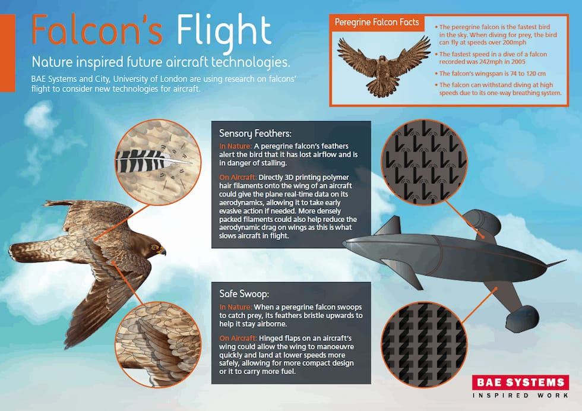
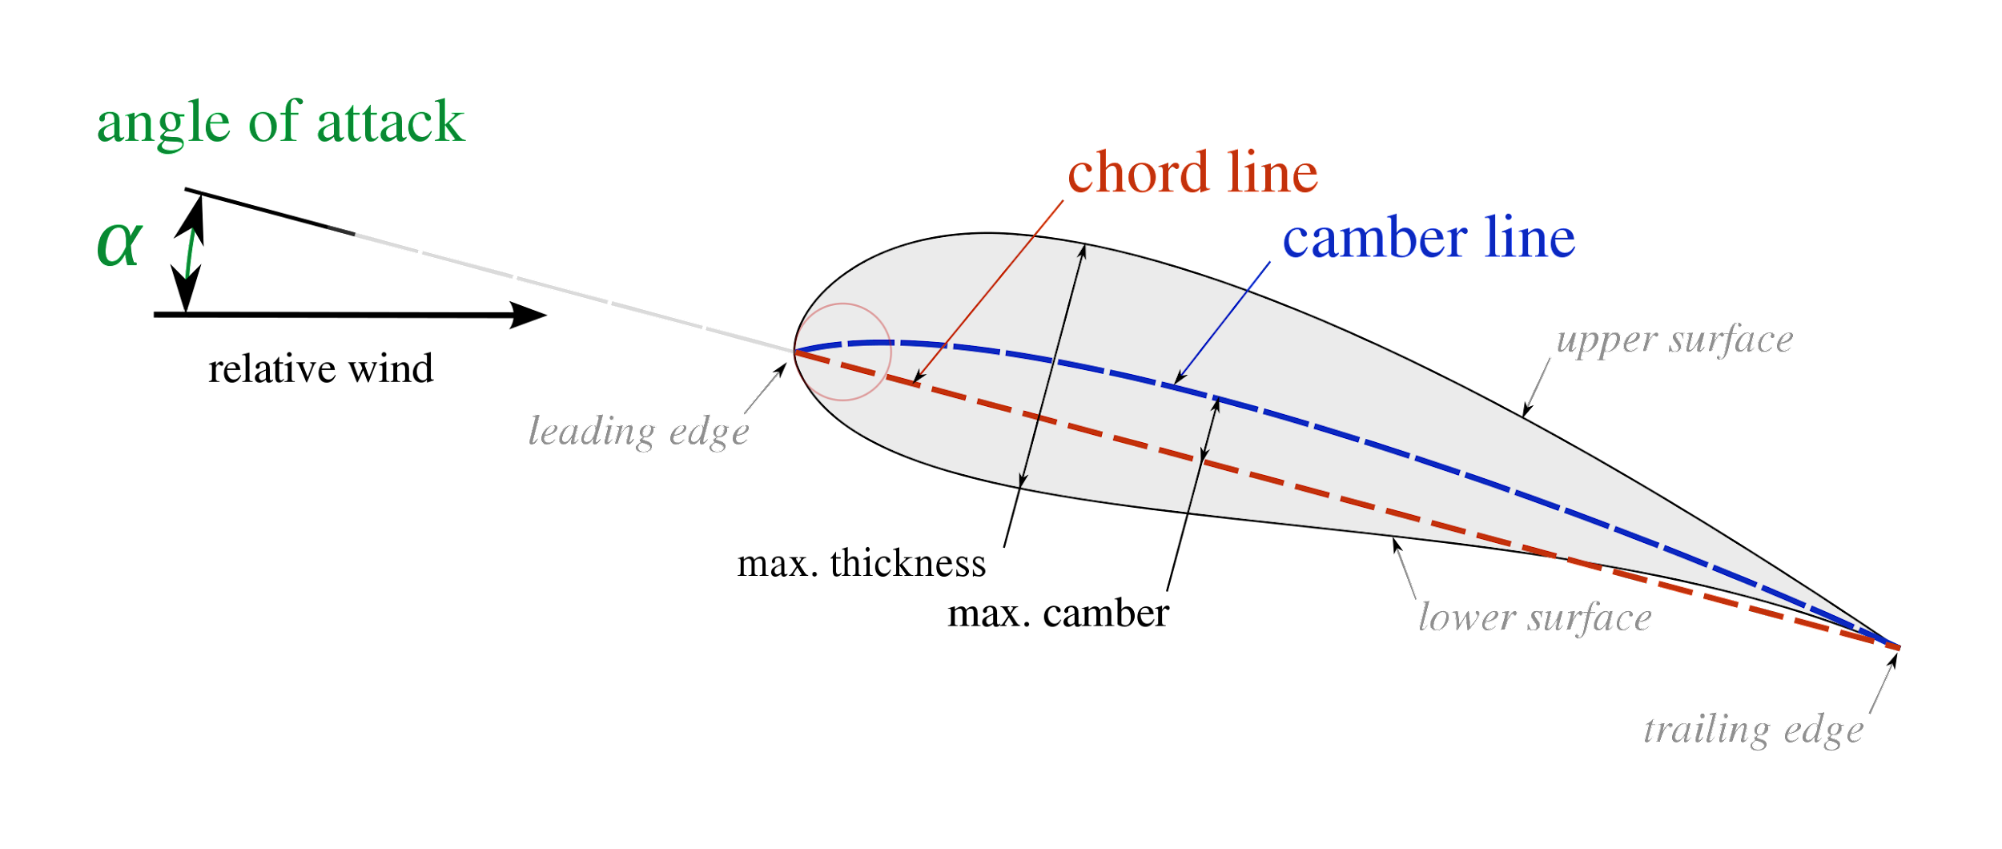
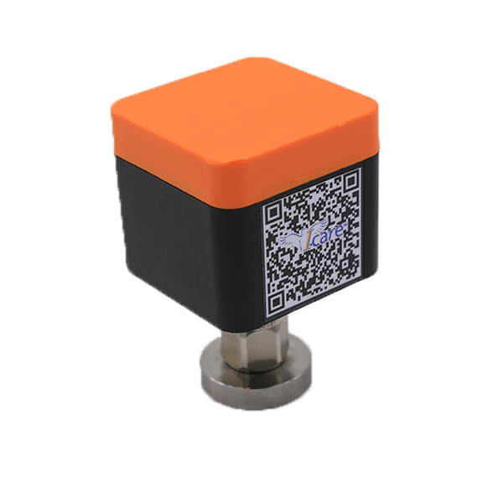
IMPLEMENTATION AND FEASIBILITY
How we want to implement our idea :-
3D printing of polymeric structure in the shape of hair filaments equipped with modern day sensors to provide real time data of the present location , velocity , pressure , air flow and many other flight parameters.
Necessity :-
High speed flight of the aircraft at supersonic levels coupled with high angle of attack may cause Stalling flow over the aerofoil . In this stalled situation , there is a very large turbulence zone above the aerofoil and the laminar boundary layer separation point comes over the aerofoil . At the stall, the airflow across the upper cambered surface ceases to flow smoothly and in contact with the upper surface and becomes turbulent, thus greatly reducing lift and increasing drag.
Sensory Feathers on Falcon
How it will work
Our work focuses on implementation of control of falcon on their diving flight. The secondary feathers vibrational amplitude helps the bird to can the angle of inclination according instabilities.
The body becomes more streamlined when the wingspan is more V-shaped, so we are trying to implement an in-air mechanism which will control this feature.
As feathers act as a vibrotactile sensors that can detect mechanical stimuli flight and provide tactical navigation, we can mimic these in form of mechanosensors.
So we mount many small mechanical fin like feathers along the upper part of the wing, these will help of modern day devices like accelerometer will provide a real time analysis of the system. With inputs related to amplitude sensing and the flow vibration and output is the calibrated flight conditions.
The localized sensors made of piezoelectric sensors can be employed along the airfoil surface to indicate the sensory vibration along the airfoil. Thus, these actuators can perform to prevent stall.
Also, inclusion of these feather like fins can be placed on surfaces with retarded streamline to improve the streamline of the structure by a certain mark.
Piezoelectric Sensor

Slide 5
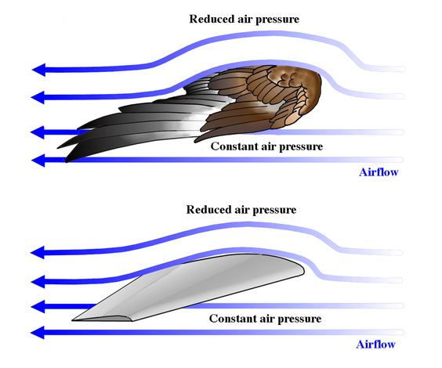
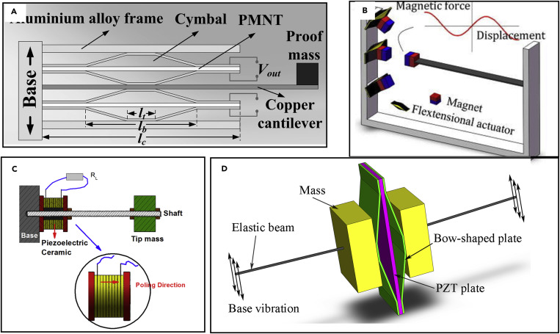
VALUE PROPOSITION
There are already existing flight models which have adapted the streamline of the falcon and have shown massive improvements of the flight as a whole.
Even though there are better models, our proposed model is superior in the sense:-
Provides a real time boundary layer situation such instabilities are detected accurately due to numerous sensors on the airfoil.
In aerodynamically degraded region it can also be provided as tools to improve flight stability.
Prevention of stalling in aeroplane can help the airline with fuel economy.
As the fins are relatively small it’s easy to mount.
Piezoelectric element is relatively smaller in size with respect to the mechanical system.
It is also implemented as an actuator in UAVs , so providing a parameter in commercial flights with this implementation can help improve the flight dynamics and the fuel economy.
CONCLUSION
By means of the biomimiced sensory feathers , we want to impart flight stability , easy maneuverability of flights and ultimately a lesser resistive (Drag force). All of these will ultimately come down to lesser fuel consumption and thus a strong economical point of view .
THANK YOU

